Slide 1


Windows Server 2016 Primer
Wisconsin VMUG- March 3, 2017
Mike Nelson, WI-VMUG Co-Leader
MVP, CTP, vExpert
@nelmedia
Windows Server 2016

Slide 2
In A Nutshell
Licensing
NanoServer
Containers
Software Defined “Everything”
Clusters
Remote Desktop Services
AD Security & Identity
PowerShell
Hyper-V
Linux
Azure

Slide 3
SMT
But First… Cool Tools
Server Management Tools
WMIX

Slide 4
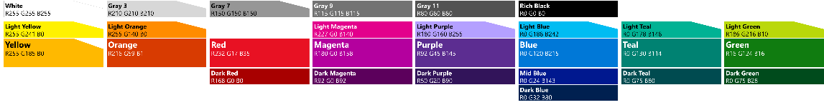
Evolution
Windows Server 2008 R2
System Center 2007 R3
Windows Server 2012
System Center 2012
Windows Server 2012 R2
System Center 2012 R2
Microsoft Azure
Windows Server 2016
System Center 2016
Microsoft Azure
Introduced virtualization platform/ management
Industry-leading scale and performance
Azure as design point
Cloud-first innovation: Infrastructure and application platform

Slide 5
Trivia
Total number of *Major Server OS Revisions released?
12
When was Windows NT3.1 released?
July 1993
NT3.1, NT3.5, NT3.51, NT4, 2k, 2k3, 2k3R2, 2k8, 2k8R2, 2k12, 2k12R2, 2016
What does “NT” stand for?
New Technology
How many lines of source code in Server 2012?
2008R2 had ~60 million
Shy of 40m

Slide 6
The Cloud Connection
Windows Server 2016 The operating system that powers Azure & your business
Advanced multi-layer security
Azure-inspired, software-defined
Cloud-ready
application platform
Privileged identity protection
Secure virtualization platform
Breach resistance
Built-in compute, storage and network virtualization
Hyper-Converged to Hyper-Scale
Traditional & cloud-native apps
Containers & microservices
Azure Hybrid Use Benefit

Slide 7

“Hardware is already becoming a commodity. Soon, it will no longer matter.”

Slide 8
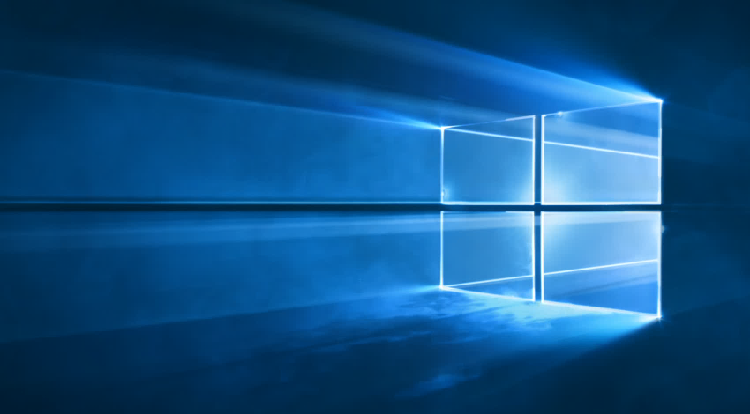
GUI
Full GUI is optional and not the default install
Look & Feel of GUI install is almost the same as Win 10 (Desktop Experience)
ServerCore is minimal GUI
NanoServer has no GUI
GUI = nice & easy but…
GUI = 60%+ larger attack surface, 40%+ more patches

Slide 9
Server 2016 Licensing
Datacenter, Standard (Essentials)
Sold in 2 core packs
‘8’ & ‘16’ are the magic numbers
Cost stays if 16 cores or less on single server
More than 16 cores, must buy another core license
Example: Server with 2 Proc’s with 8 cores each = same cost
Example: Server with 2 proc’s with 16 cores each = cost is ~doubled~
Per Physical Core licensing
Required minimum 8 core license required per physical socket
Minimum 16 cores required to be licensed for servers with one Proc
Required to license 2 processors (even with only 1 processor)
Previously Per Socket

Slide 10
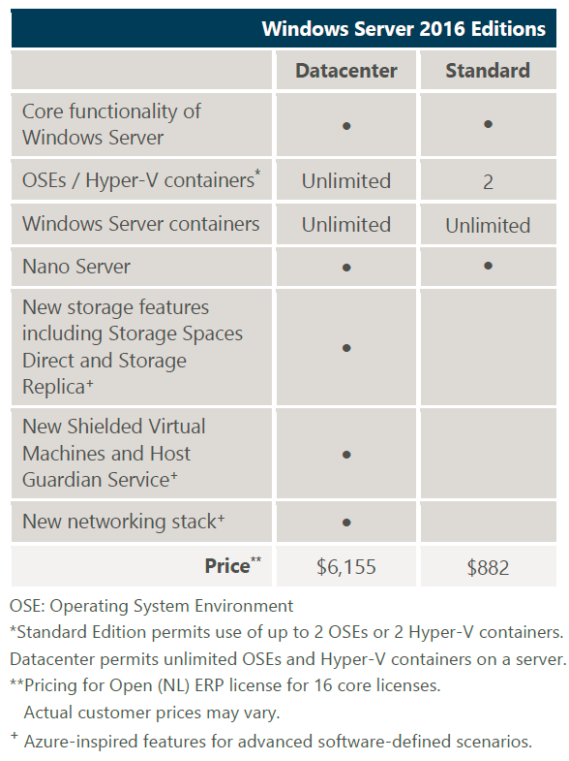
Same base licensing cost as 2012R2
CAL requirements & licensing does not change from 2012R2
VD licensing is not *expected* to change. SA still covers the VDA. Thin clients that do not run Win OS will require non-SA VDA purchase.
Nested Virtualization requires Datacenter edition.

Slide 11
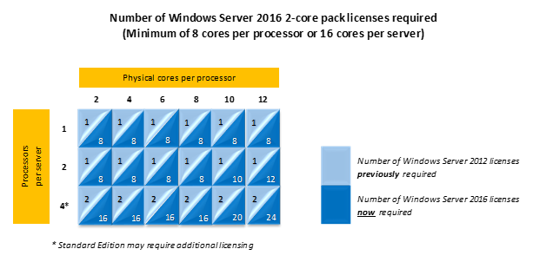
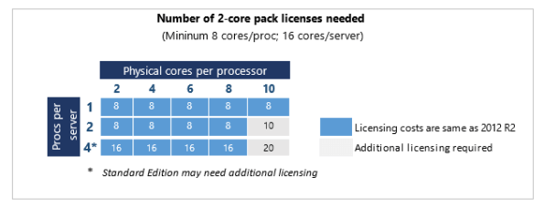
Licensing Cost Comparison – 2012R2 vs 2016

Slide 12
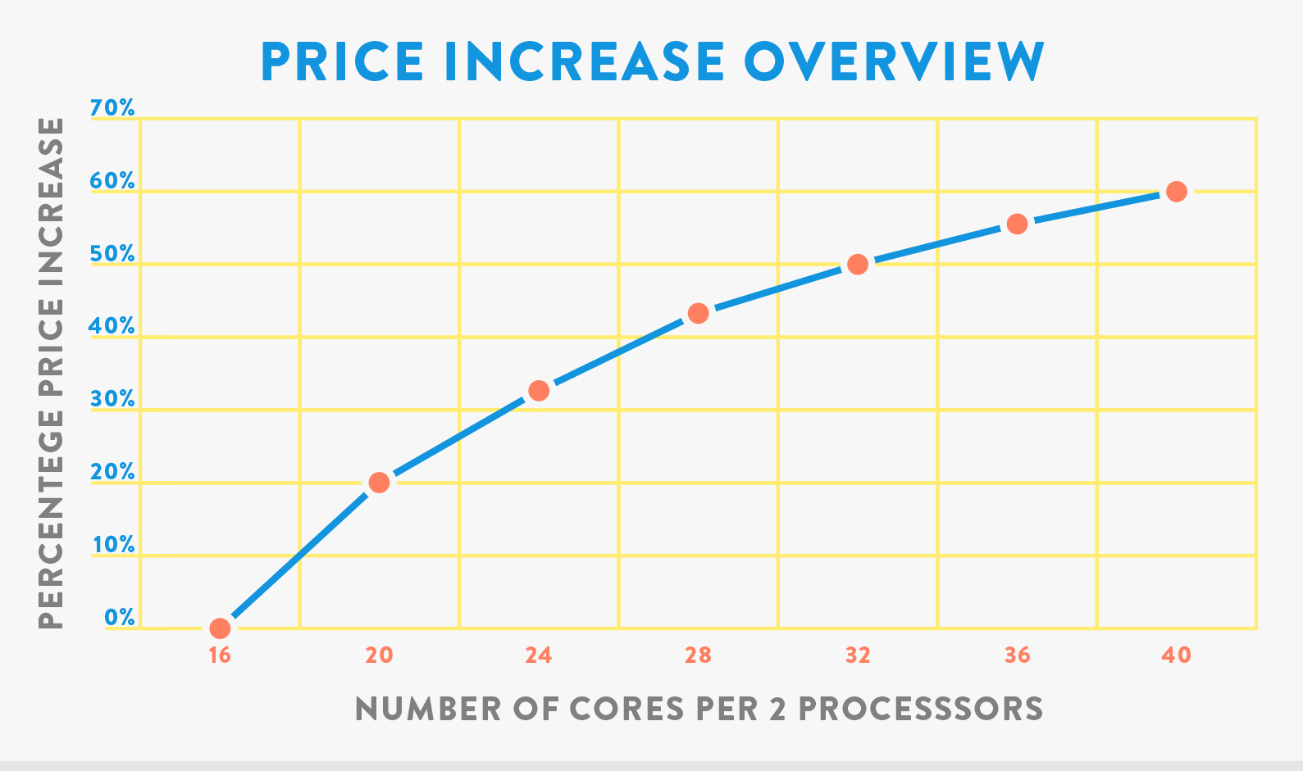
Incremental Core Cost Increase

Slide 13
Licensing Server 2016 in ESXi
Standard edition allows for 2 OSE’s
Datacenter edition is unlimited OSE’s
~14 VM’s is breakpoint between Standard & DC
For 8 VM’s, 4 x Standard 2-core pack licenses required
You license the cores – 1 license covers 2 cores
vMotion (DRS/HA) must be accounted for

Slide 14
Nano Server Just enough OS
Different, yet familiar
Reduced attack surface and servicing requirements - patching
Full Windows Server PnP driver support
Antimalware optional package
System Center VMM and OM agents available
5.42
30
12
.46

Slide 15
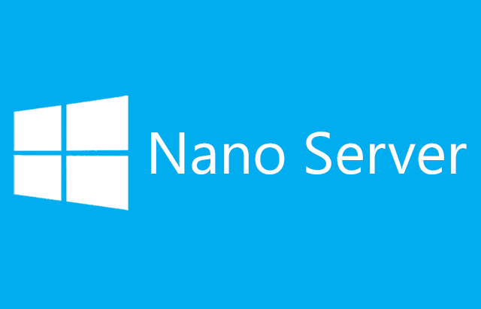
Nano Server
No GUI – CLI, PoSH, Web, WMI, etc.
Rescue Console (console & EMS) login only
No RDP
No 32bit support
No MSI installer (full AppX coming)
“Refactored” (i.e. Restructured) Server code
It Powers Azure
Install is very different & very fast! Boot time is <5 seconds*
No upgrade path from Nano to Core or GUI
Requires SA

Slide 16
Containers
Windows Containers
Hyper-V Containers (nested virtualization – secure)
Docker & PowerShell management
Portable between On-Premises & Azure (&…?)
Cross-Platform containers may be coming soon to a Server OS near you ;-)
It’s not just about DevOps anymore…

Slide 17
Active Directory
Privileged Access Management (PAM)
Creates bastion AD forest w PAM trust to existing forest
“Clean” forest with isolation for privileged accounts
Conditional Access Control (CAC)
auth strength for MFA, device compliance, user identity, etc. set on per-app basis
LDAPv3, OpenID & OAuth support for ADFS
Azure AD Join
Azure AD Connect Health
Group membership expirations
Passport
Biometric or PIN
One Time password (OTP), Phone-factor, or other
Domain time sync enhancements
2003 server domain join warnings (may not allow join)

Slide 18
Remote Desktop Services
App-V Native – Client already in Win10
Shared Desktop Workspaces
Multipoint Services
vGPU enhancements – OpenGL & OpenCL
Multiple sessions can access Direct Device Assignments (DDA) – mainly video
Concurrent connection storms
10k+ concurrent connection requests without failure)
HA Connection broker with shared SQL backend
Azure AD integration

Slide 19
Server Management & PowerShell
Automate Everything
PowerShell DSC – big improvements & expansion
PowerShell is Open Source
Gallery & PowerShell GitHub
Granular role-based management
PowerShell Just Enough Administration (JEA)
Cloud-based Server Management Tools
Manage any Windows servers, anywhere
Integrated with Azure
SC** in the Cloud (OMS)
OMS major revisions in-step with server releases

Slide 20
Clustering
Clusters without domains
Independent of domain topology - Can be mixed between domains
Can be domain members or workgroup members
Rolling upgrades with 2012R2 in same cluster
Full, Core, or Nano mix
Storage Replica for Clusters
Any type of storage
Auto-failover for fast RTO
Node Fairness
Site Awareness
Grouping of nodes in stretched cluster which correspond to physical location
Instances auto failover to node in same site first, different site second
Cloud Witness
Utilize Azure blob for cluster resiliency
Stretch to Cloud
Node quarantine
Stops flapping nodes

Slide 21
File Services & Storage
ReFS (Resilient File System) starts replacing NTFS
Deduplication
Still post-process
No ReFS support initially
Storage Spaces Direct (EoS – MS SDS)
Cluster with no tiered storage – can do 2 node (not a typo)
No single point of failure
Commodity hardware, no external enclosures
NVMe SSD’s, SATA, SAS, Spindles, Flash, DAS, etc.
SMB v3 (SMB v4)
Storage Replica
End-to-End DR solution
Server-to-server, cluster-to-cluster
Volume level replication between any storage
Sync or Async replication
Auto-Failover for Clusters
Notes:
NTFS - 1993

Slide 22
File Services & Storage
Storage QOS
SMB Multi-Channel
StorSimple Appliance – On-Prem & Azure
Health Service
Physical disk lifecycle automation
Retire, un-retire, remove, balance operations
Storage “Allow List”
XML list – allows for quarantine for rogue storage
Drive firmware orchestration
Storage Maintenance Mode
Notes:
NTFS - 1993

Slide 23
Networking
IPAM 2016
DR, multiple instance, cross AD support
Tracking activity, utilization & trend, audit
Granular DNS properties, single console across all DC’s
Network Function Virtualization
VA’s for FW/Anti-Virus/WAN Optimize/S2S/L2-L3 gateways/LB’s/Routers/Switches/NAT/Proxy, etc.
Switch-embedded teaming (Hyper-V & SDN)
PacketDirect
NDIS to the next level (100G+)
Network controller
Single central point of automation for any virtual any physical network in DC
Firewall mgmt., fabric mgmt., network monitoring, service chaining, SLB, VPN, etc.
Shielded VM’s
Host Guardian
SDN stack that works with Azure

Slide 24
Hyper-V
Nested virtualization (huge step)
Direct Device Assignments (DDA) - video
Hot add NIC’s and RAM
VM Resiliency (BSOD recovery)
Shielded VM’s
Host Guardian

Slide 25
Linux Subsystem
WSL – Windows Subsystem for Linux
Not an “emulated” Linux kernel
Ubuntu Bash shell
User & kernel mode
Limited & a bit flakey so far

Slide 26
Thank you!
Q&A

